Slide 1
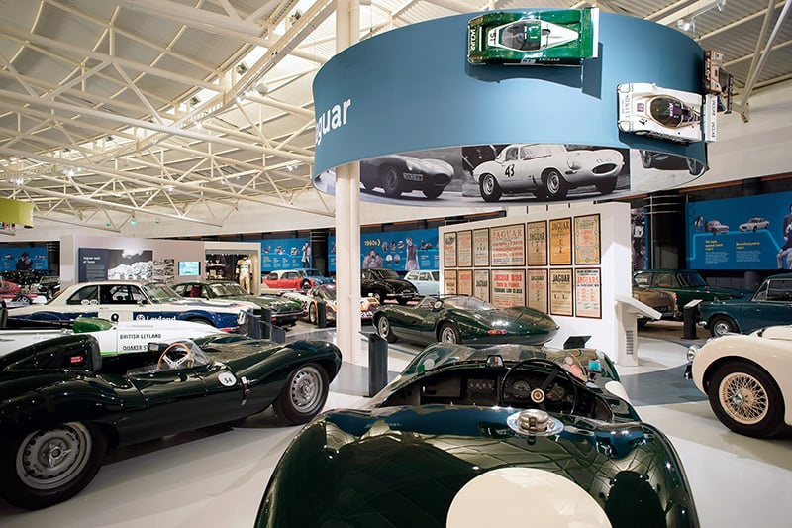



80TH ANNIVERSARY CONFERENCE
18th September 2025
British Motor Museum, Warwickshire
Exhibitor and Sponsor Opportunities

Slide 2
ABOUT THE EVENT
Join us as we mark 80 years of innovation, expertise, and collaboration in the electro-mechanical industry. This milestone event will bring together end users, rewinders, repair specialists, and industry leaders to explore the challenges and opportunities shaping our future.
  Connect with end users from key industries, including power generation, water, manufacturing, transport, and more.
  Engage with rewinders and service providers, who play a crucial role in extending the life cycle of critical equipment.
  Discover cutting-edge technologies in condition monitoring, motor efficiency, and sustainable engineering solutions.
  Learn from expert-led discussions on improving business processes, driving sales, and embracing a more sustainable future.
  Address the skills gap with a strong focus on apprenticeships and the next generation of electro-mechanical engineers.
Whether you’re an AEMT member, an OEM, service provider, supplier, or end user, this event is your opportunity to network, gain valuable insights, and shape the future of our industry.
Don’t miss out – be part of this landmark event.

Slide 3

ABOUT THE VENUE
The British Motor Museum, located in Warwickshire, is one of the UK's leading attractions for automotive enthusiasts and history lovers alike. Home to the world's largest collection of historic British cars. Celebrating the past, present and future of British motoring. the museum offers a fascinating journey through the history of the British motor industry, from its earliest days to the modern era.
With over 300 vehicles on display, including iconic models from brands like Aston Martin, Jaguar, Land Rover, Mini, and Rolls-Royce, the museum provides a unique insight into the technological and design evolution of British cars. The collection spans more than 100 years of motoring history, making it a truly special venue for anyone interested in cars, design, and engineering.

Slide 4

FLOOR PLAN
STAGE
The conference will feature an engaging programme, including:
✓ Insightful talks from thought leaders on sales, procurement and people culture
✓ Dynamic panel discussions
✓ Interactive workshops
MAIN HALL
BREAKOUT
ROOM 1
RECEPTION
BREAKOUT
ROOM 2

Slide 5

EXHIBITOR
  Exhibitor stand
Why Exhibit?
  Target largest gathering of Rewind Service Centres in the UK.
  Reinforce your brand with AEMT Members.
  Feature in post Conference photos, video and media.
  Launch new products.
  Demonstrate new services.
  Display your company logo & profile on the Conference website and in the keynote theatre.
  Free entry for two delegates.
£900
+ VAT

Slide 6
SPONSORSHIP
GOLD
Thank you for considering sponsoring our event. We are thrilled to offer a range of opportunities to help you get maximum visibility and engagement with attendees.
Whether you’re looking to showcase your brand with a prime space or align yourself as a key partner of the AEMT, we have a sponsorship package for you.
  Pre and post event promotion
  Pop up banners in reception and throughout venue (provided by company)
  Sponsor logo on all social media, handouts and newsletters
  Logo on lanyards
  Free exhibitor space - Size to be agreed
  Conference bar/simulator at booth
  20min speaking slot if wanted
  6 free guest passes
  Priority space in exhibitor hall
  Access to promotional video for future company marketing
£3.5k + VAT

Slide 7
SILVER
Evening Drinks
  Break out room named after company (Apprentice or Engineering)
  Logo on social media and, handouts and newsletters
  Logo on lanyard passes
  Free exhibitor space
  4 free guest passes
  Logo on all promotional material and screens
  Priority space in exhibitor hall
  Drinks reception and toast in the motor museum followed by an hour walking around the cars
£2k + VAT
£2k + VAT

Slide 8

BOOK YOUR SPACE
Email Scott or Rebecca, scott@theaemt.com or rebecca@theaemt.com to discuss your options or to book your space today.
Read our Terms & Conditions here.

